Slide 1
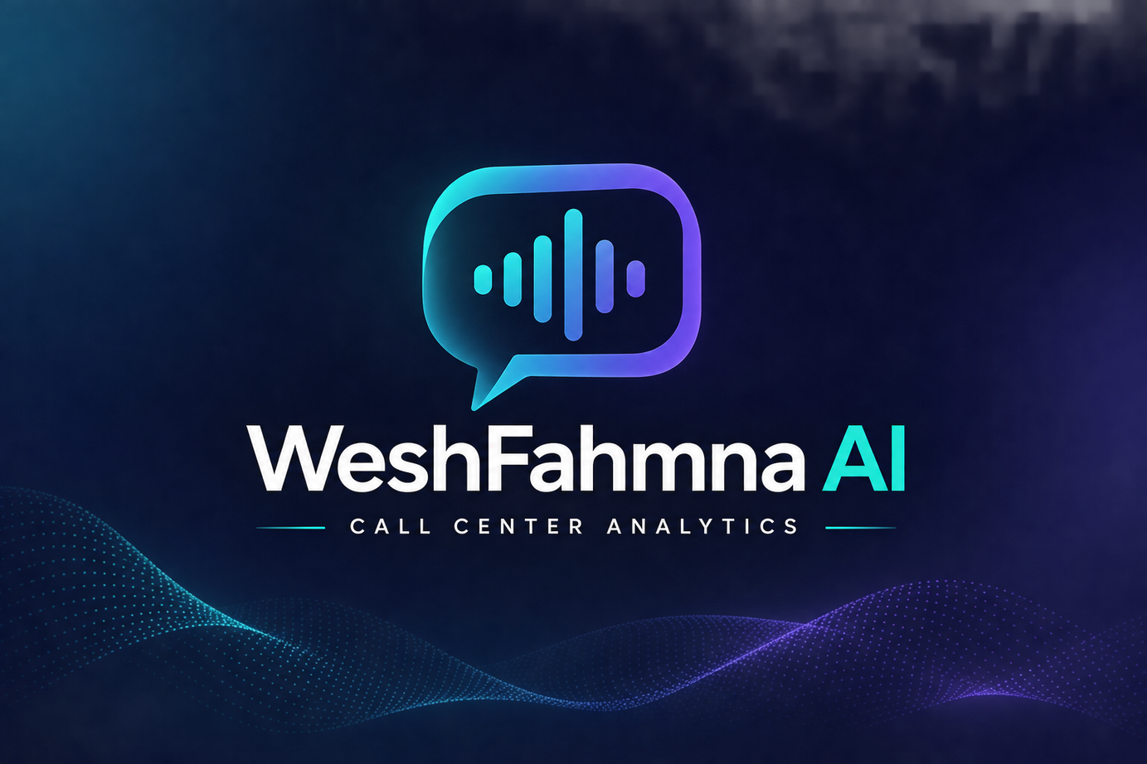
WeshFahmna AI | وش فهمنا ؟
Call Center Conversation Intelligence
From Conversations to Clear Insights
  Maharah GDP | AI Technical Assessment
  Presented by Yasir Aladwani
  November 2026

Slide 2
Every Conversation Contains Valuable Insights
Customer-service calls hold valuable information that is slow to analyze manually. Our goal: transform raw audio into structured, understandable insights.
Raw Audio
AI Processing
Actionable Insights
01 Transcription
02 Speakers
03 Summarization
04 Sentiment
Convert speech into text.
Speaker identification: distinguish customer and agent turns.
AI summarization: extract issues, actions, and outcomes.
Sentiment analysis: understand customer language and emotional trends.

Slide 3

Research-Driven Dataset Selection
Structured comparison of datasets and research literature before implementation.
16
15
96/100
Datasets Reviewed
Papers & Articles
AppTek Suitability Score
Selected dataset: AppTek Call-Center Dialogues
Why AppTek
  Agent-customer conversations
  Reference transcripts and speaker labels
  Multiple accents and service domains
  Timestamped annotations for evaluation
Project-specific dataset suitability scores, not official benchmarks or model accuracy.

Slide 4
Understanding the Data
873
12 Calls
118.83
Conversations — full dataset
Our evaluation pilot
Minutes of Audio
8
4
776
Service Domains
Accent Groups
Speaker Turns
English-language, role-played customer-service conversations with reference annotations.

Slide 5
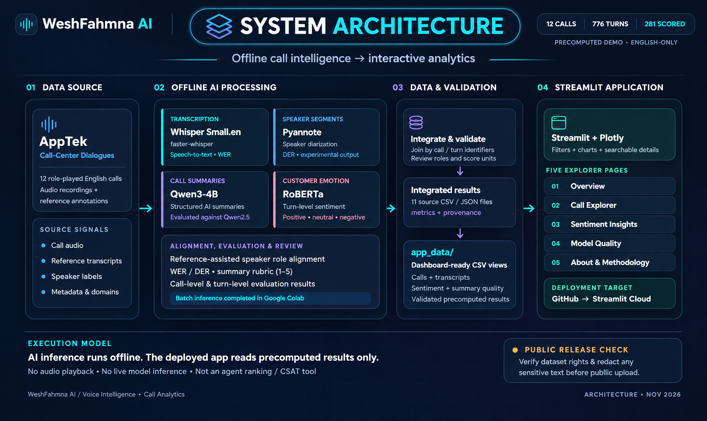
How WeshFahmna AI Works

Slide 6

Evaluating Speech Understanding
20.85%
18.24%
19.93%
Mean Word Error Rate
Filler-Adjusted WER
Mean Diarization Error Rate — speaker diarization
2.61 percentage points
Filler normalization reduced reported WER; speaker attribution remained challenging in some conversations.
Average call-level errors across the 12-call pilot. Lower is better. Filler normalization changes the evaluation calculation, not the ASR model.

Slide 7
Turning Conversations into Structured Summaries
LONG CONVERSATION
↓
Customer Issue
Agent Action
Final Outcome / Next Step
3.31 / 5
3.83 / 5
Qwen2.5-3B-Instruct average quality
Qwen3-4B-Instruct-2507 average quality
Head-to-head
7 calls
4 calls
1 tie
Qwen3 better
Qwen2.5 better
Equal review score
Qwen3 achieved stronger average summary quality in our pilot. Project-specific review-rubric scores, not standardized benchmarks.

Slide 8

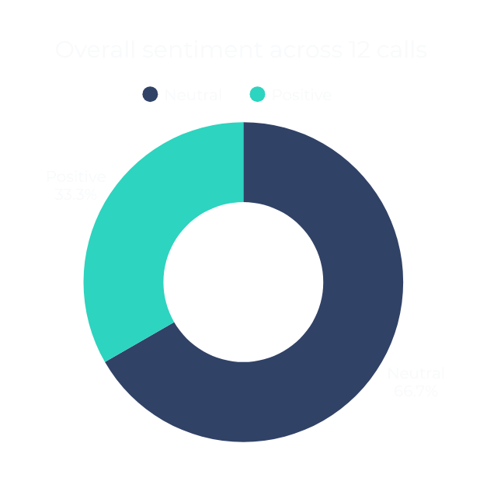
Understanding Customer Sentiment
8 Neutral • 4 Positive • 0 Negative
181 Neutral • 79 Positive • 21 Negative
Negative customer moments appeared even in calls classified neutral or positive overall.
Sentiment reflects model-classified language, not verified customer satisfaction.

Slide 9
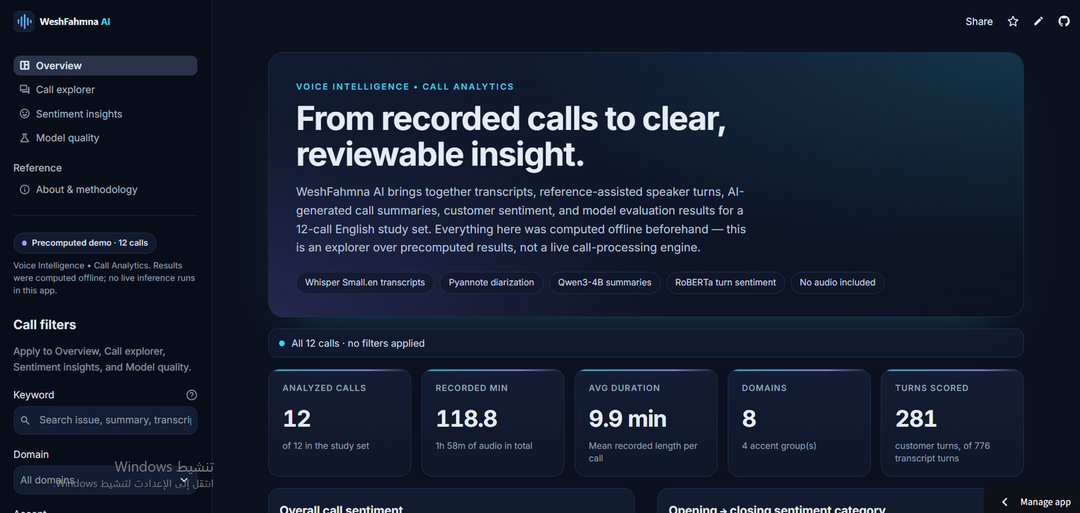
From AI Models to a Working Application
WeshFahmna AI Dashboard — an interactive Streamlit application for exploring conversation insights and model evaluations.
Executive Overview
Call Explorer
Sentiment Insights
Model Quality
Methodology
LIVE DEMO • weshfahmna-ai.streamlit.app

Slide 10
What We Learned
01 Speech Recognition Errors
02 Speaker Attribution
03 LLM Reliability
Accents, fillers, and natural speech affected transcription quality.
Lesson: Measure accuracy against reference transcripts.
Some conversations produced significant diarization errors.
Lesson: Keep predicted labels separate from reference-assisted roles.
Generated summaries occasionally misinterpreted details or outcomes.
Lesson: Evaluate factual accuracy and preserve uncertainty.
Reliable AI requires validation, transparency, and human oversight.

Slide 11

Thank You
An end-to-end AI prototype combining Speech Recognition, Speaker Analysis, LLM Summarization, Sentiment Analytics and Interactive Visualization.
Future improvements: expand evaluation beyond 12 calls; improve independent speaker attribution; strengthen factual verification of AI summaries.
Live Application • weshfahmna-ai.streamlit.app
GitHub • github.com/Yasir-Aladwani/WeshFahmna-AI
Yasir Aladwani • Maharah GDP • November 2026

